Slide 1
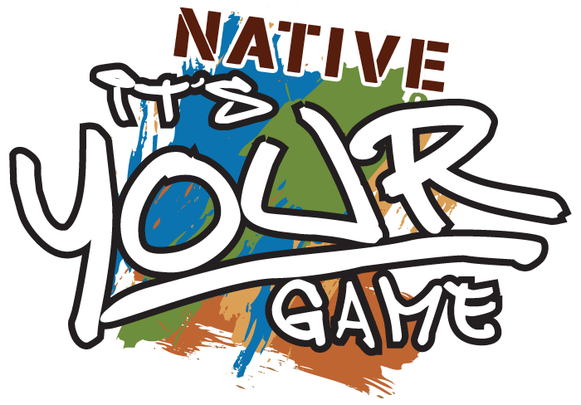
Native It’s Your Game: A Multimedia Sexual Health Program for American Indian/Alaska Native Youth Funded by Administration of Families and Children and Centers for Disease Control
ALASKA NATIVE TRIBAL HEALTH CONSORTIUM
INTER TRIBAL COUNCIL OF ARIZONA, INC.
NORTHWEST
PORTLAND AREA INDIAN HEALTH BOARD
UNIVERSITY OF TEXAS PREVENTION RESEARCH CENTER

Slide 2
Workshop Objectives
By the end of this presentation participants will be able to:
Develop considerations when adapting evidence-based programs for AI/AN youth.
Describe the short-term psychosocial impact for Native It’s Your Game.
Organize strategies for implementing Native It’s Your Game program within their tribal community.

Slide 3
Notes:
And this is our team…We are a group of tribal educators and sexual health experts who came together to design Native It’s Your Game; an online sexual health curriculum designed specifically for American Indian/ Alaska Native youth ages 12-14.

Slide 4
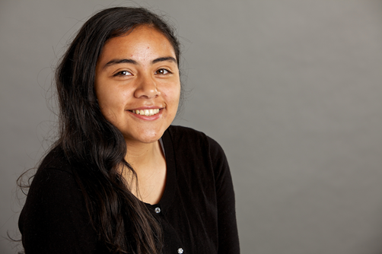
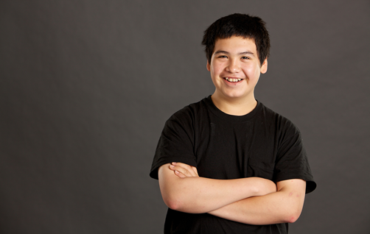
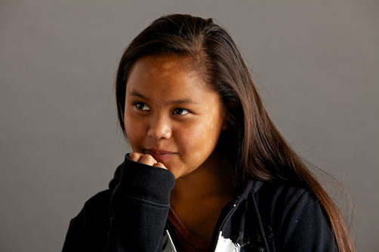
Adolescent sexual Health
2012: AI/AN teens (15-19 y.o.) had the third highest teen birth rate reported among all races and ethnicities 1
35 per 1,000 population
29 per 1,000 for the nation as a whole
2010: AI/AN teens (15-19 y.o) had the highest prevalence of repeat teen births among all race and ethnicities 2
21.6%
14.8% among White youth
Figures 2:-4 We R Native, Mitchelldyer Photography
Notes:
To provide context for folks who haven’t worked with Native youth, our teens experience numerous inequalities associated with sexual and reproductive health.
This is evidenced in higher teen birth rates than the national average, along with the highest prevalence of repeat teen births, and the second highest rates of sexually transmitted infections (STIs) compared to non-Hispanic Whites.

Slide 5
Adolescent sexual Health
2012: AI/ANs had the second highest rate of chlamydia reported among all races and ethnicities
728.2 per 100,000
4 times the rate of Whites (179.6 per 100,000)
Notes:
To provide context for folks who haven’t worked with Native youth, our teens experience numerous inequalities associated with sexual and reproductive health.
This is evidenced in higher teen birth rates than the national average, along with the highest prevalence of repeat teen births, and the second highest rates of sdexually transmitted infections (STIs) compared to non-Hispanic Whites.

Slide 6
It’s Your Game (IYG) - Goal
To adapt and evaluate the effectiveness of an Internet-based HIV/STI & pregnancy prevention program for middle school-aged youth (12-14 years old) in three geographically dispersed American Indian/Alaska Native (AI/AN) communities in Alaska, Arizona & Pacific Northwest.
Notes:
Very few evidence-based HIV, STI, and pregnancy prevention programs exist for early-adolescent AI/AN youth indicating a need to develop or adapt such programs
Through funding from CDC and ACF, our goal has been to adapt and evaluate the effectiveness of an internet-based HIV/STI & pregnancy prevention program for middle school-aged youth (12-14 years old) in Alaska, Arizona, and Pacific Northwest.
We adopted a community-based participatory research approach to equitably involve tribal communities and maximize their ownership in the development of thi program.

Slide 7
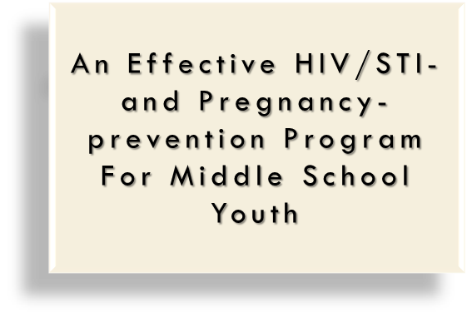
It’s Your Game…Keep It Real
Theory-based, multimedia program for 7th & 8th grade
Two randomized controlled trials
Effective outcomes by follow-up at 9th grade
Delayed initiation of sexual intercourse
Reduced frequency of sex
Increased condom use
Positive impact on psychosocial variables
Notes:
So a little background on It’s Your Game…
Theory-based-in Social Cognitive theory and models of influence.

Slide 8
IYG Tech: Lessons & Topics
Notes:
13-35 minute lessons comprising of healthy relationships, puberty and reproduction, HIV/STIs, pregnancy, refusal and communication skills, and contraception.

Slide 9
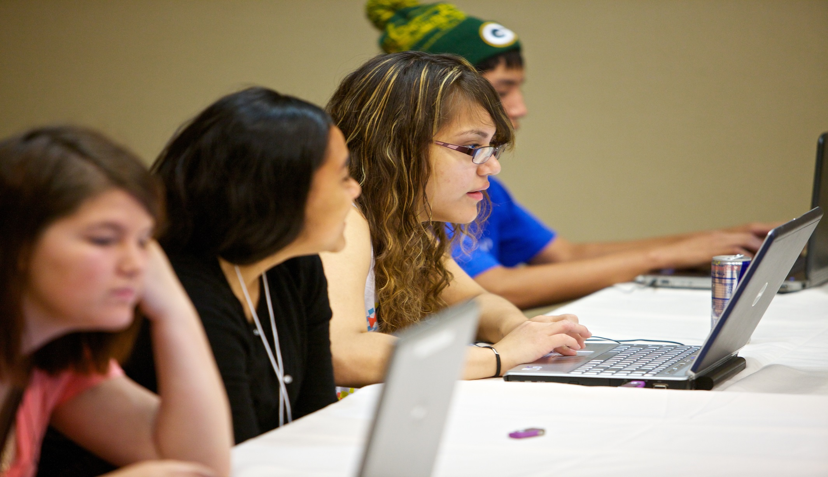
Phase 1: IYG usability testing and Adaptation
Notes:
Phase I of our process involved testing the original curriculum with Native youth and adult stakeholders across Alaska, Arizona, and the Pacific Northwest.
Each group ranked the program on a scale of usability measures to identify elements of the program that resonated with their tribal experience, as well as identify elements of the program that did not resonate with Native youth and adult community members.

Slide 10
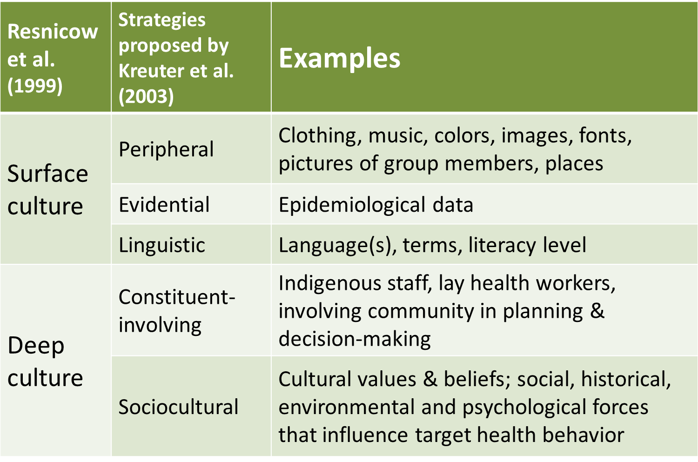
Adaptation strategy
Notes:
We revised the conceptual framework of the program to better align with the personal values, environmental factors, and behavioral influences of Native youth.
We used Resnicow’s research to prioritize surface and deep cultural adaptations. For example, surface cultural changes were made to things like clothing, location, music, and our logo. While deep cultural chnages involved changes to cultural values, beliefs, environmental and psychological forces that influence sexual health behaviors.
Both youth and parents brought up the need for better education on dating violence and healthy relationships. They also brought up topics like sex hapeening in places where drugs and alcohol were present. They also wanted the program to address mental health, which is an ever growing concern, as suicide rates in AI/AN communities are high.
Throughout the adaptation process we used intervention Mapping, a stepped framework for developing evidence-based health promotion programs.

Slide 11
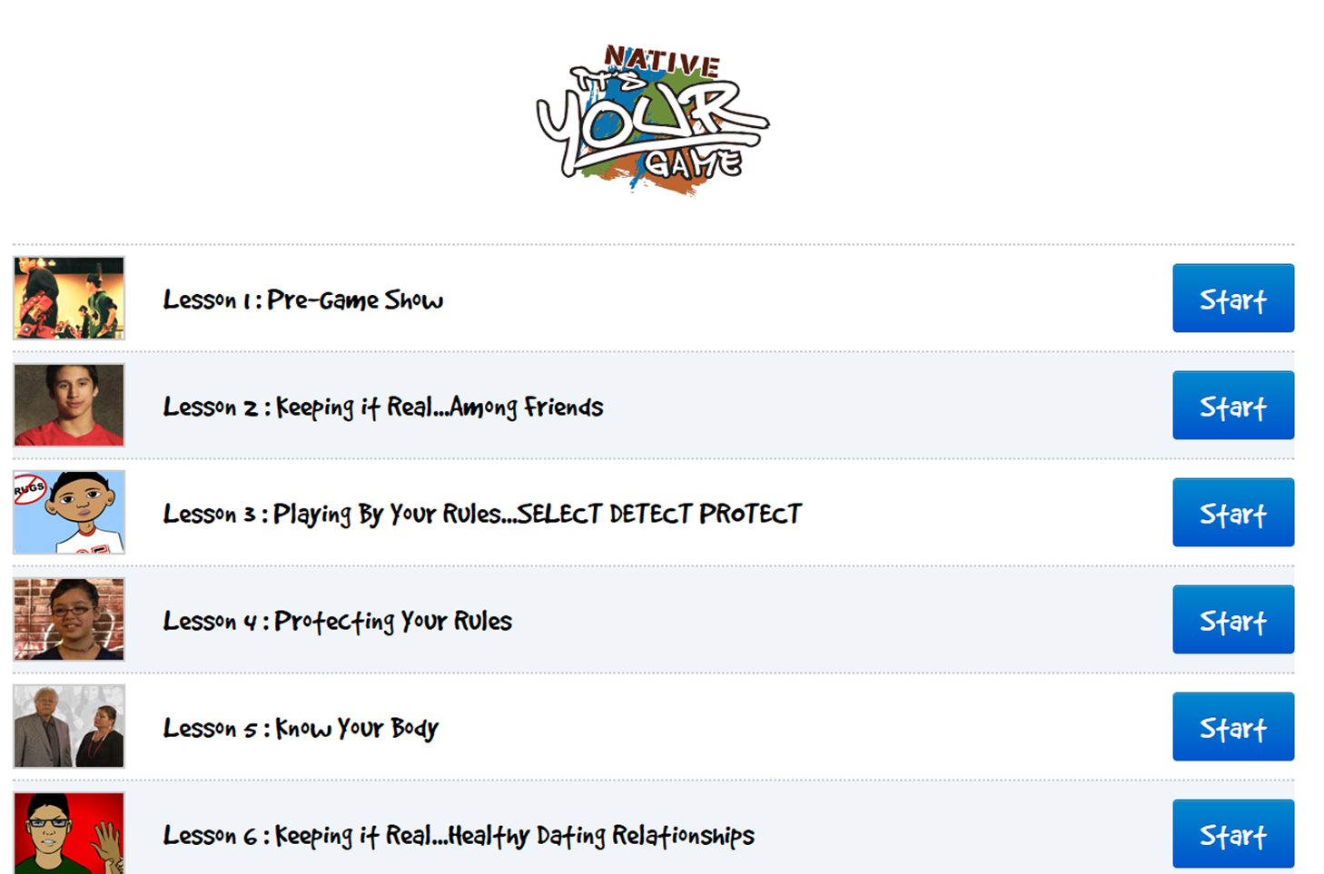
Notes:
The end product is the Native It’s Your Game program, which includes 13 internet-based lessons, each lasting 30-35 minutes. The lessons include a mix of videos, interactive activities, quizzes, animation, and journal activities.
Lessons covers healthy relationships, puberty and reproduction, HIV/STIs, pregnancy, refusal and communication skills, and contraception.

Slide 12
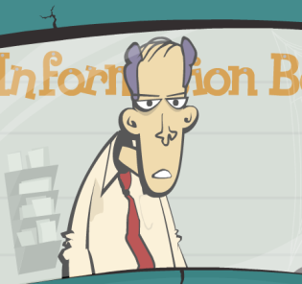
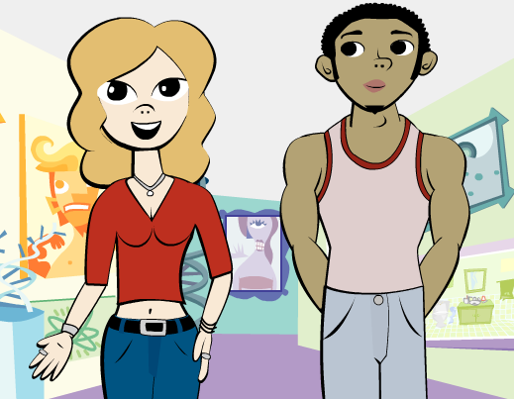
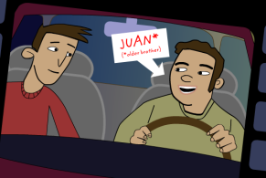
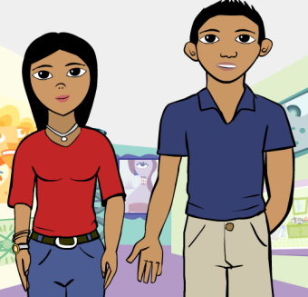
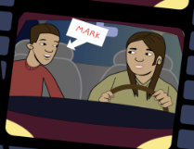
Surface level changes
Notes:
In addition to changing the intro video and program name and logo, the animated guide went from a dry, self-depreciating older character to a young, hip Native security guard. The animated youth guides were changed from being chiseled, slender, mid-drift baring animations to more conservative relatable characters.
Other small changes were made to character names, images, slang, and locations.

Slide 13
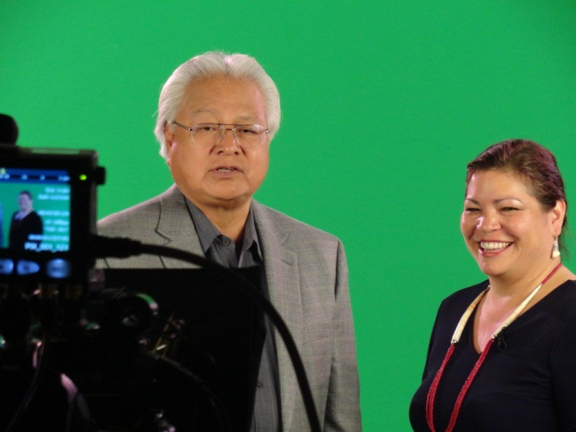
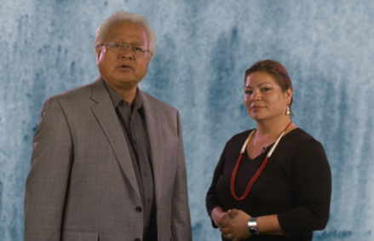
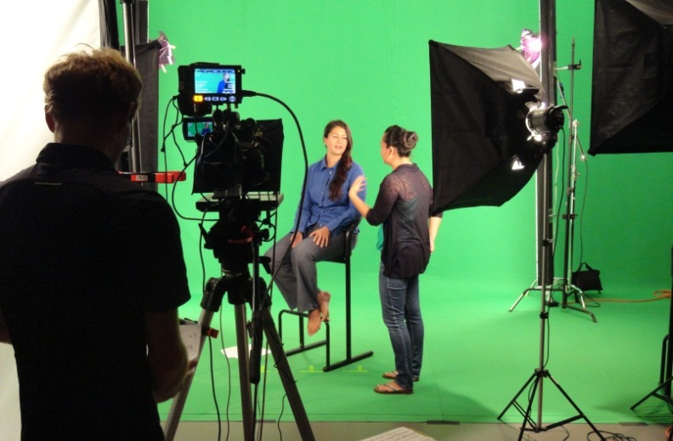
Tribal Elders & native health expert
Notes:
We also included a number of deep cultural changes include the addition of videos featuring Native youth, elders, and a health education ‘sexpert’ who reflect tribal and youth perspectives.
The elders introduce the curriculum and provide a holistic framework around sexual health that is familiar to tribal communities. They also help to provide a cultural context to sensitive topics like the anatomy and physiology, which both youth and adults had a hard time felt a bit uncomfortable with during the usability testing.

Slide 14
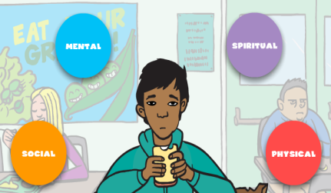
Cultural adaptations
Notes:
Another important deep cultural value incorporated was a shift towards a more traditional holistic view of sexual health in reference to the Native Wellness Model, which is an integration of physical, social, emotional, mental, and spiritual dimensions of health and wellbeing.
The idea is to create a balance of these dimensions to affect the overall health and wellbeing on an individual and its community.

Slide 15
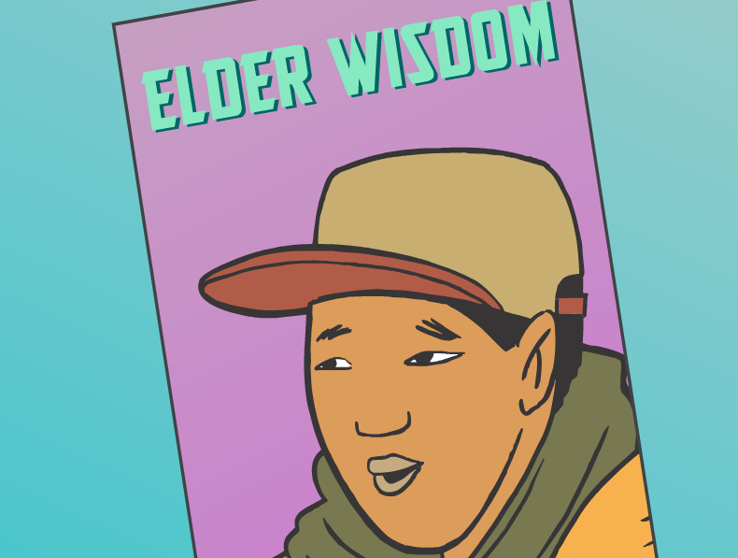
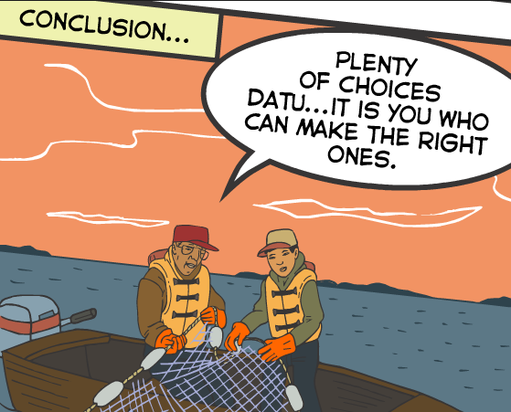
Cultural adaptations
Notes:
The original program included a fortune teller activity that framed teen pregnancy outcomes in a way that was not relevant to Native communities, as well as being topic of taboo.
The replacement activity is told from the viewpoint of an Alaska Native elder who frames teen pregnancy as a life choice while exploring the pro’s and cons of waiting, and keeping in mind that some participants may be teen parents themselves.

Slide 16
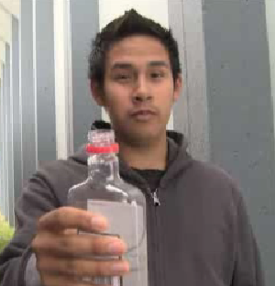
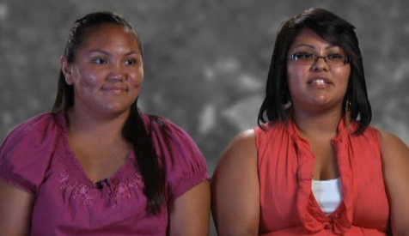
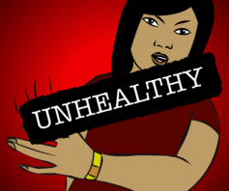
Youth Videos
Notes:
One of the other feedback from youth, was they wanted to see more videos portraying native youth.

Slide 17
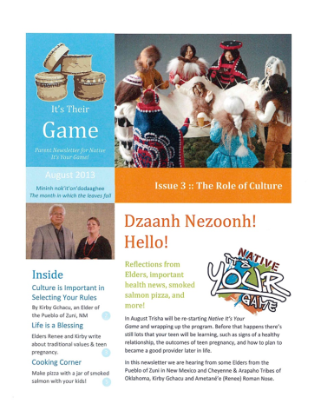
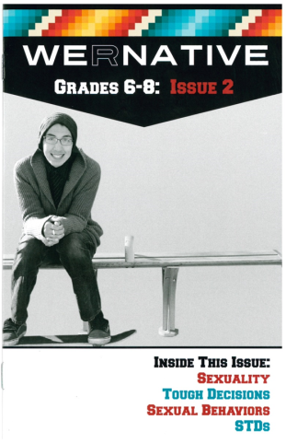
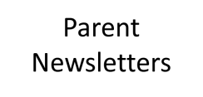
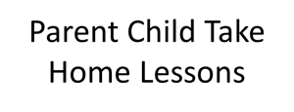
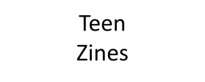
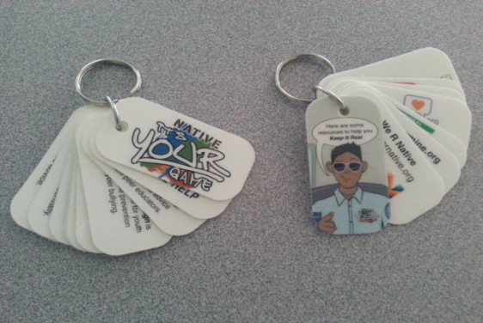
Elements of the Parent Child Component
Notes:
Feedback from adult stakeholders prompted us to add a parent-child communication component to the curriculum. The communication activities included teen and parent newsletters. The newsletters gives tips on how to talk to your teens about sensitive topics and provides information about what their child(ren) are learning as they go through the curriculum. There are also homework activities designed to facilitate dialogue between the parent and child around friendships, dating, and sexual behavior. We also provide fact sheets (part of the lessons) and resources to all youth.
After the adaptation phase, we re-tested the adapted program with a new group of youth and adult stakeholders, and found improvements in likability ratings, credibility, and motivational appeal.

Slide 18
PHASE 2:
EVALUATION
Notes:
*Show lesson 1 and part of lesson 9.*
After the adaptation phase, we re-tested the adapted program with a new group of youth and adukt stakeholders, and found improvements in likeability ratings, credibility, and motivational appeal.
This gave us some reassurance that a more rigorous evaluation was warranted.

Slide 19
Effectiveness study: by the numbers
2 study arms: Native IYG and Control
25 Tribal Sites randomized
3 regions: AK, NW, AZ
574 middle school aged youth enrolled
3 surveys: Pre, Post, 12-month follow-up
Notes:
During the 2nd phase of the study…
We recruited 25 sites representing 18 Tribes/communities to participate in the RCT. Of the 18 Tribes/communities, 11 are rural and 7 are urban, 14 sites received the Native IYG intervention and 11 received the comparison intervention. The control condition comprised five health-related computer-based programs that addressed tobacco smoking (ASPIRE), hearing (Dangerous Decibels), alcohol (N-Squad) and drugs (Reconstructors), and diet and physical activity (Quest to Lava Mountain). The control programs were delivered in a standard number of sessions (n=13) and duration (approximately 35 minutes) that approximated a comparable learning ‘time on task’ to NATIVE-IYG.
574 youth enrolled (#of youth who returned valid parental consent and youth assent forms).
We collected survey data from youth who completed the program at three different stages: baseline, immediate follow-up, and a again at 12 months.

Slide 20
RESULTS
Notes:
*Show lesson 1 and part of lesson 9.*
After the adaptation phase, we re-tested the adapted program with a new group of youth and adukt stakeholders, and found improvements in likeability ratings, credibility, and motivational appeal.
This gave us some reassurance that a more rigorous evaluation was warranted.

Slide 21
Baseline: factors associated with Sexual experience
Participants were 12-14 years old
Sample was 55% female
Mean age was 13.2 years
6.5 % were sexually experienced
Notes:
The analytical sample was 55.1% female, with a mean age of 13.2 years (standard deviation = 1.06 years); 6.5% were sexually experienced.
If someone asks…
Lifetime sexual experience = a composite variable comprising lifetime experience of oral sex and vaginal sex. Youth often initiate oral sex and vaginal sex at a similar age; however, each sexual behavior contributes unique risk for STI and pregnancy.
We defined oral sex as “When someone puts his or her mouth on their partner’s penis or vagina, or lets their partner put his or her mouth on his penis or her vagina and vagina sex as, “When a boy puts his penis inside a girl’s vagina.”

Slide 22
Factors associated with sexual experience
lower intentions to have oral or vaginal sex (psychological factors)
avoidance of risky situations,
nonuse of alcohol (behavioral factors)
They were all associated with lower odds of lifetime sexual intercourse (p<.01)
Notes:
In the final model, we found that lower next –year intentions to have oral or vaginal sex (psychological factors), avoidance of risky situations, and nonuse of alcohol (behavioral factors) were associated with lower odds of lifetime sexual intercourse (all p<.01). No other variables were significantly associated with lifetime sexual intercourse.
Conclusions: Interventions that reduce sexual intentions, exposure to risky situations, and alcohol use may help to delay sexual initiation among AI/AN early adolescents.

Slide 23
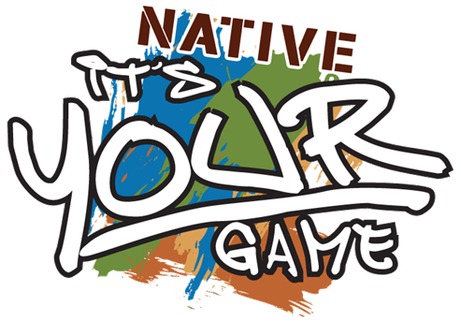
Youth who took Native iyg reported:
More reasons not to have sex
Increased STI knowledge
Increased condom knowledge
More confidence about obtaining condoms
More confidence about using condoms
More likely to seek education beyond high school
Retained knowledge about condoms
Notes:
The good news! From Pre-test to Post-test…
Five psychosocial variables (of 16 examined in the study) were significantly impacted by Native IYG:
Increased reasons not to have sex
Increased STI and condom knowledge
Increased condom and condom use self-efficacy (they were more confident obtaining and using condoms)

Slide 24
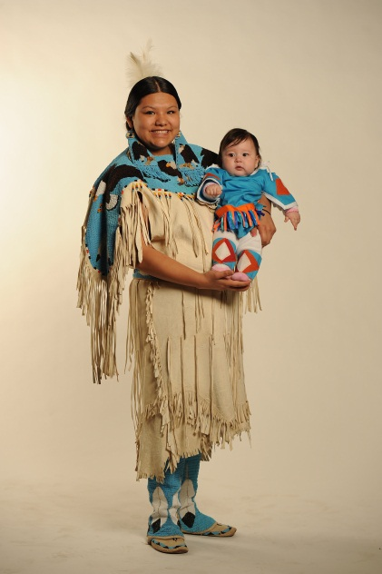
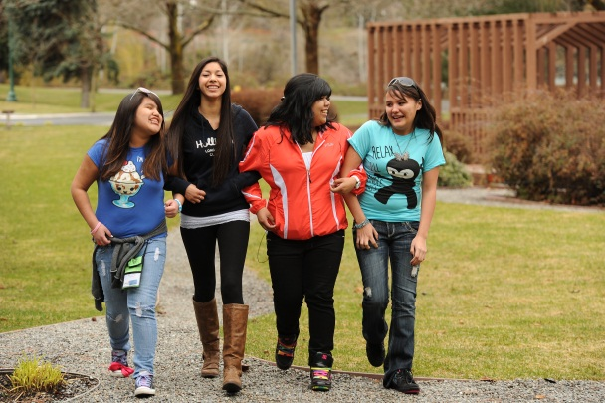
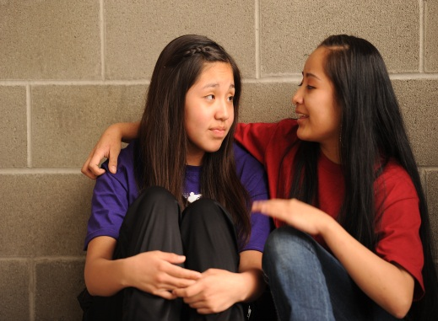
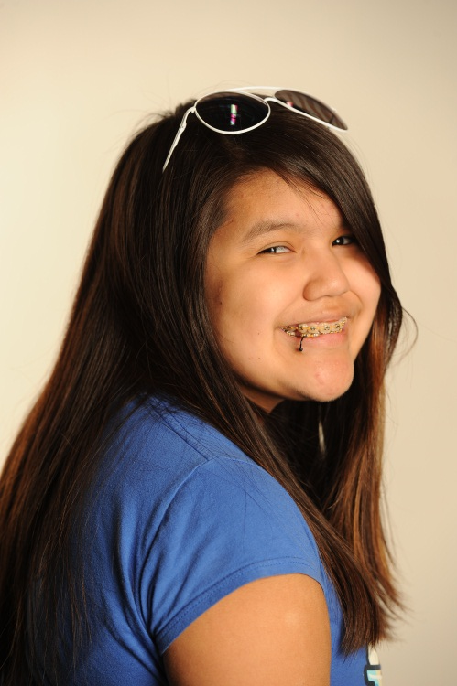
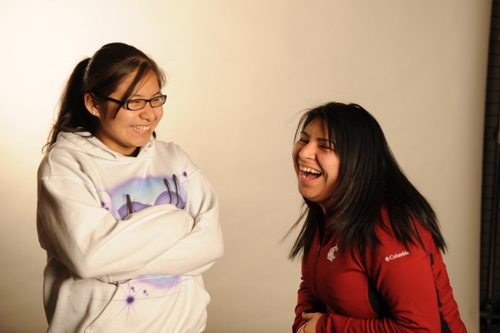
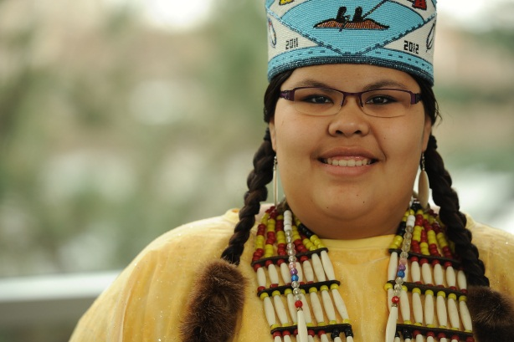
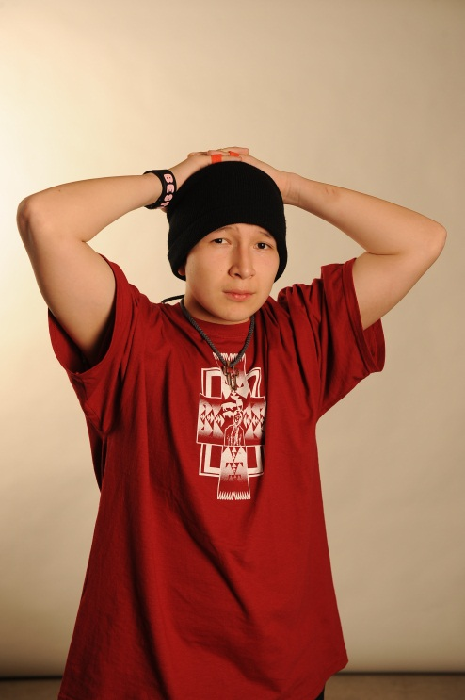
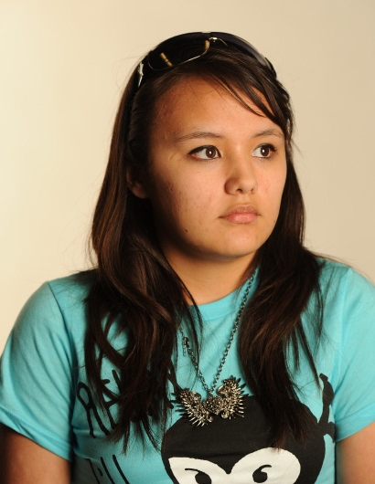
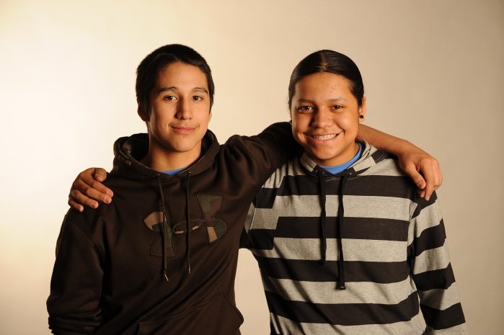
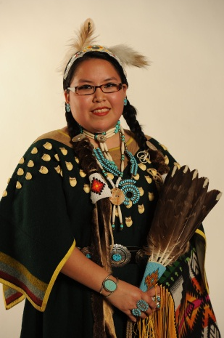
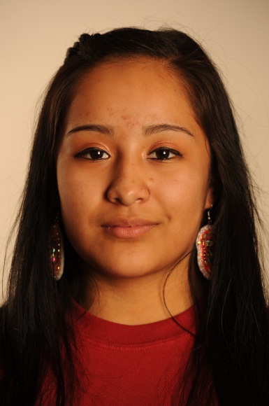
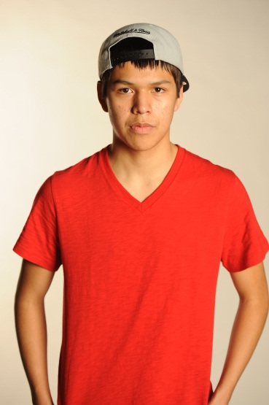
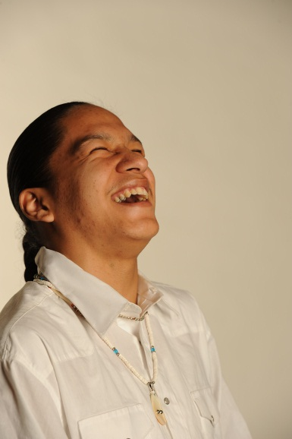
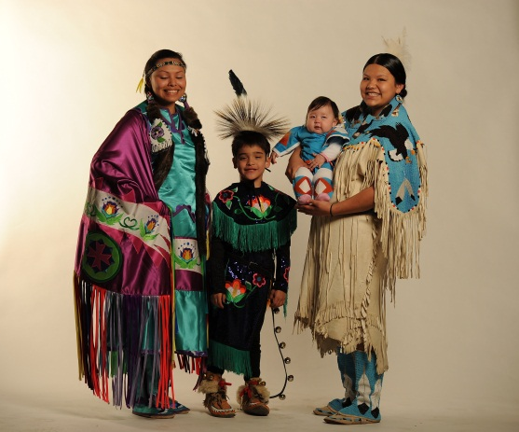
Notes:
Most importantly, we hope that we have achieved our goal of creating a health resource that reflects and includes the experiences of Native youth and the communities they come from.
Making Native It’s Your Game a curriculum that weaves the diverse faces, voices, experiences, and cultural values that can be shared with not only tribal communities, but with other multicultural communities across the US.
We want Native youth to know that they belong and are part of the story too.

Slide 25
Thank you! Questions?
Inter Tribal Council of Arizona, Inc.
Gwenda Gorman, gwenda.gorman@itcaonline.com
Northwest Portland Area Indian Health Board
Stephanie Craig, Scraig@npaihb.org
Amanda Gaston, Agaston@npaihb.org
Alaska Native Tribal Health Consortium
Cornelia Jessen, cmjessen@anthc.org
Jennifer Williamson, jjwilliamson@anthc.org
University of Texas School of Public Health
Ross Shegog,
Ross.Shegog@uth.tmc.edu
Christine Markham,
Christine.Markham@uth.tmc.edu
Chrystial Correa,
chrystial.c.correa@uth.tmc.edu

