Slide 1
School AND community-based
NATIVE YOUTH DEVELOPMENT PROGRAM

Slide 2
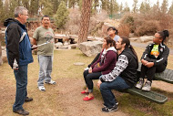
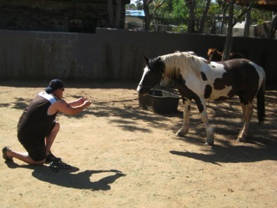
Rationale & Purpose
In Indian Country, tribal and community leaders are keenly aware of the challenges faced by their teens.
Our challenge, in terms of community readiness is to move community leaders beyond recognition of the problem to actual commitment of resources to evidence-based interventions.
Notes:
What is the rationale and the purpose for the creation of Native STAND?

Slide 3
What does it “STAND” for?
Native
Students
Together
Against
Negative
Decisions
Notes:
Native STAND -- The acronym “STAND” means = Students Together Against Negative Decisions.

Slide 4
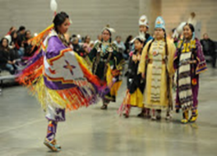
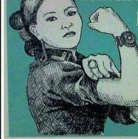
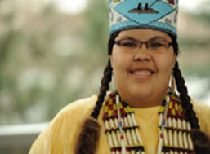
Introduction to Native STAND
Healthy decision-making curriculum for enhancing and promoting positive Native youth development and well-being.
Notes:
One such solution and tool that is available to both tribal communities and tribal youth is the Native STAND curriculum.

Slide 5
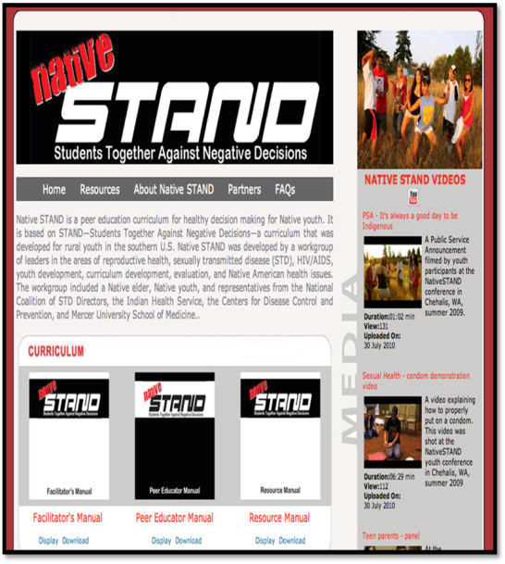
From stand to Native stand
Original STAND was created by Mike Smith, Mercer University SOM.
Reps. of National Coalition of STD Directors/I.H.S./CDC developed a work group.
Native Work Group adapted the original STAND.
Reviewed by Native Youth & Professionals.
Validated in 4 BIE schools & 1 reservation community.
Evaluated with findings.
Notes:
STAND was originally created for youth in the rural south but a Native Work Group adapted it to for Native youth and communities, which is how Native STAND was created.

Slide 6
Native STAnd
The Curriculum
CORE ELEMENTS
Facilitator’s Manual
Peer Educator Manual
Resource Manual
29 ~ 90 min. sessions
Culture and Tradition
Honoring diversity / respecting traditions
Healthy relationships
Negotiation and refusal skills
Decision making
Being a peer educator
Uses active learning
Uses primary prevention techniques
Non-judgmental attitudes
Information sharing
Advocating specific behaviors
Positive role modeling
Promoting personal commitment
Healthy, positive sexual expression in relationships
Notes:
Here are fundamentals of the Native STAND program and its curriculum. The core elements are key.

Slide 7
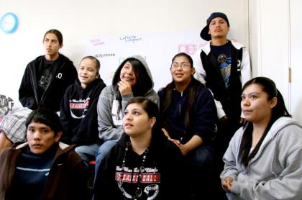
Teen measures
Youth Questionnaire on key indicators:
Condom use
STI screening
Bullying
Victim of (IPV)
Suicide attempt

Slide 8
FINDING: Native STAND Improves Knowledge!
Pre- n=70 youth Post- n = 34 youth
Notes:
The two different colors represent pre and post Native STAND implementation surveys from native youth about their knowledge – the findings is that it improves knowledge, attitudes and behavior!
Blue Bars = Pre Survey before receiving Native STAND
Red Bars = Post Survey after receiving Native STAND
Knowledge consistently improved in healthy relationships, STD/HIV Prevention and Reproductive Health in positive way as a result of implementing this curriculum in these previous locations.

Slide 9
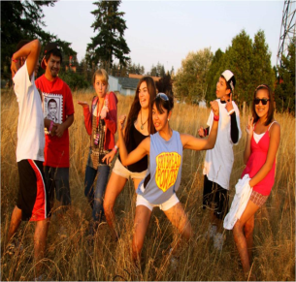
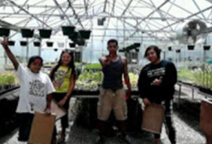
Past Evaluation Findings
Students demonstrated significant improvements in knowledge of:
STD/HIV/AIDS Prevention
Reproductive Health
Healthy Relationships
Tribal youth reported providing 1-on-1 peer education and referrals.
Adult facilitators learned how to better communicate & teach about sensitive topics.
Program was well received; recognition in addressing critical gaps in sexual health education.
Notes:
When used originally in Indian Country, past evaluation had these findings.

Slide 10
Optional Training Opportunity

Slide 11
Oregon PRC: Center for Healthy Communities
Notes:
Here is a snapshot of the work OHSU’s Center for Healthy Communities does with communities, including the Native community. They are located in Portland, Oregon.

Slide 12
WORK with TRIBES & Indian Country
Notes:
They have done work with Tribes and Indian country – the Native STAND Dissemination Project is a Core Research Project that includes Tribes and tribal organizations.

Slide 13
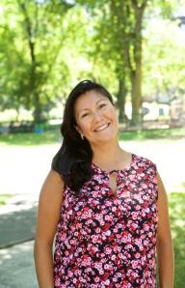
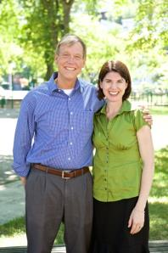
Native STAND Core TEAM
Oregon PRC
Npaihb
Bill Lambert
Michelle Singer (Navajo)
Tosha Zaback
Ashley Thomas (Hawaiian)
Tom Becker
Stephanie Craig Rushing
Jessica Leston (Tsimshian)
*Adolescent Tribal Health
*NW Tribal Epi Center
Notes:
The Core Team are located in Portland, Oregon. Pictured here are co Principal Investigators -- Drs. Bill Lambert of OHSU AND Dr. Stephanie Craig-Rushing of the Northwest Portland Area Indian Health Board – and Michelle Singer (Navajo) is the Project Manager housed at OHSU.

Slide 14
Center for healthy communities: Native STAND WWW.OREGONPRC.ORG
Notes:
OHSU has a Native STAND website about the project, the Native STAND program and the curriculum with resources for more information.

Slide 15
SUMMER RESEARCH Training Objectives
Provide an overview of the Native STAND Dissemination and Implementation Project, including it’s goals and objectives.
Prepare to teach an adolescent sexual health curriculum, with hands-on training using the Native STAND curriculum.
Prepare to recruit participants and implement the Native STAND curriculum in your community.
Notes:
This is what I learned while at the Summer Training Institute.

Slide 16
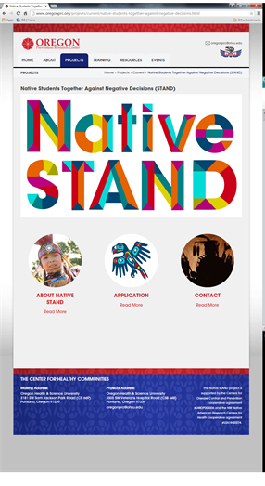
IMPLEMENTATION SUPPORT
2-year implementation funding ($5K each year)
Attend & Complete Training
Signed MOA
IRB Local Review Approval
Submitted Action Plan
1-week of hands-on training
Technical assistance
Data Collection & Evaluation
Notes:
Our organization was selected to participate and this is what is on the table for our involvement.

Slide 17
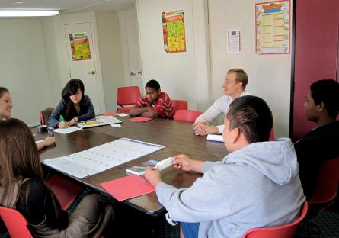
Summer Research Training Institute
1 week in Portland
Native STAND curriculum
Practice at THRIVE
Human subjects protection
Technical Assistance
Leave with action plans for home communities
Notes:
Selected educators from organizations, like ours, had the opportunity to learn in a Summer Training Institute in Portland, Oregon to bring back to our community to implement.

