Slide 1
We Are INSPIRED: Preparing AI/AN Students to Pursue Public Health Careers
Northwest Tribal Epidemiology Center

Slide 2
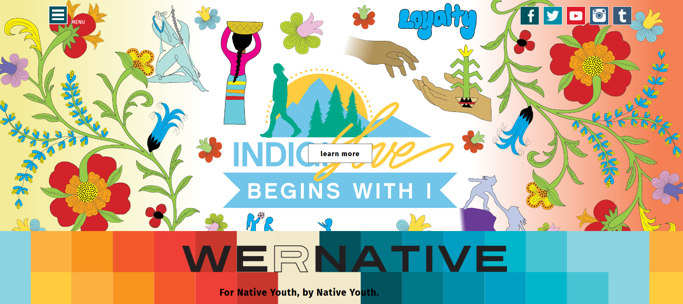
Notes:
We R Native, a multimedia health resource for Native youth, by Native youth.
As you can imagine… The competition for their time and attention online is FIERCE! So the health content on the website is deliberately subtle.

Slide 3
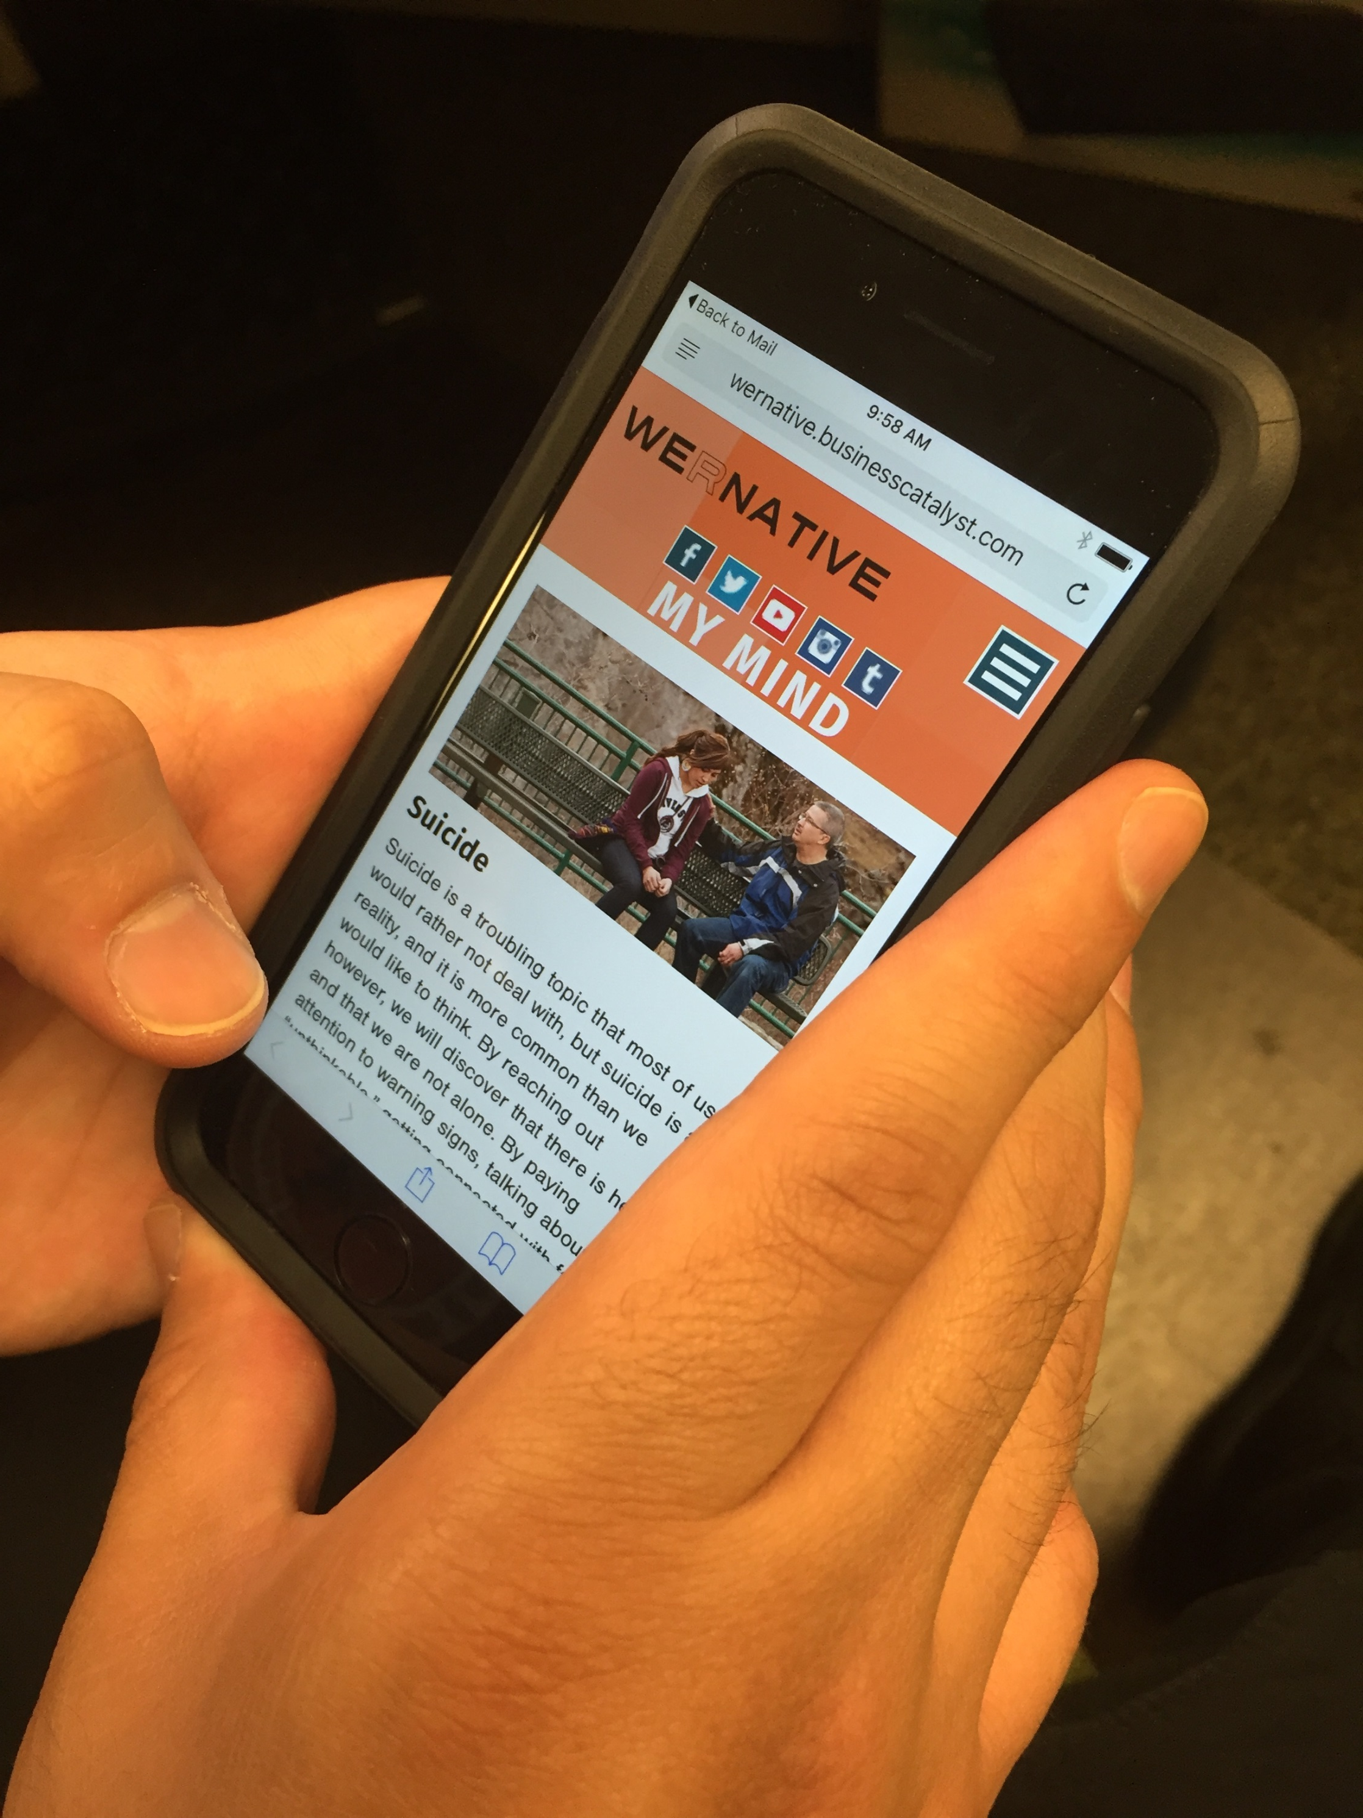
Notes:
The site includes life advice on a wide variety of topics, with over 400 health and wellness pages written and reviewed by Native youth and topical experts.

Slide 4
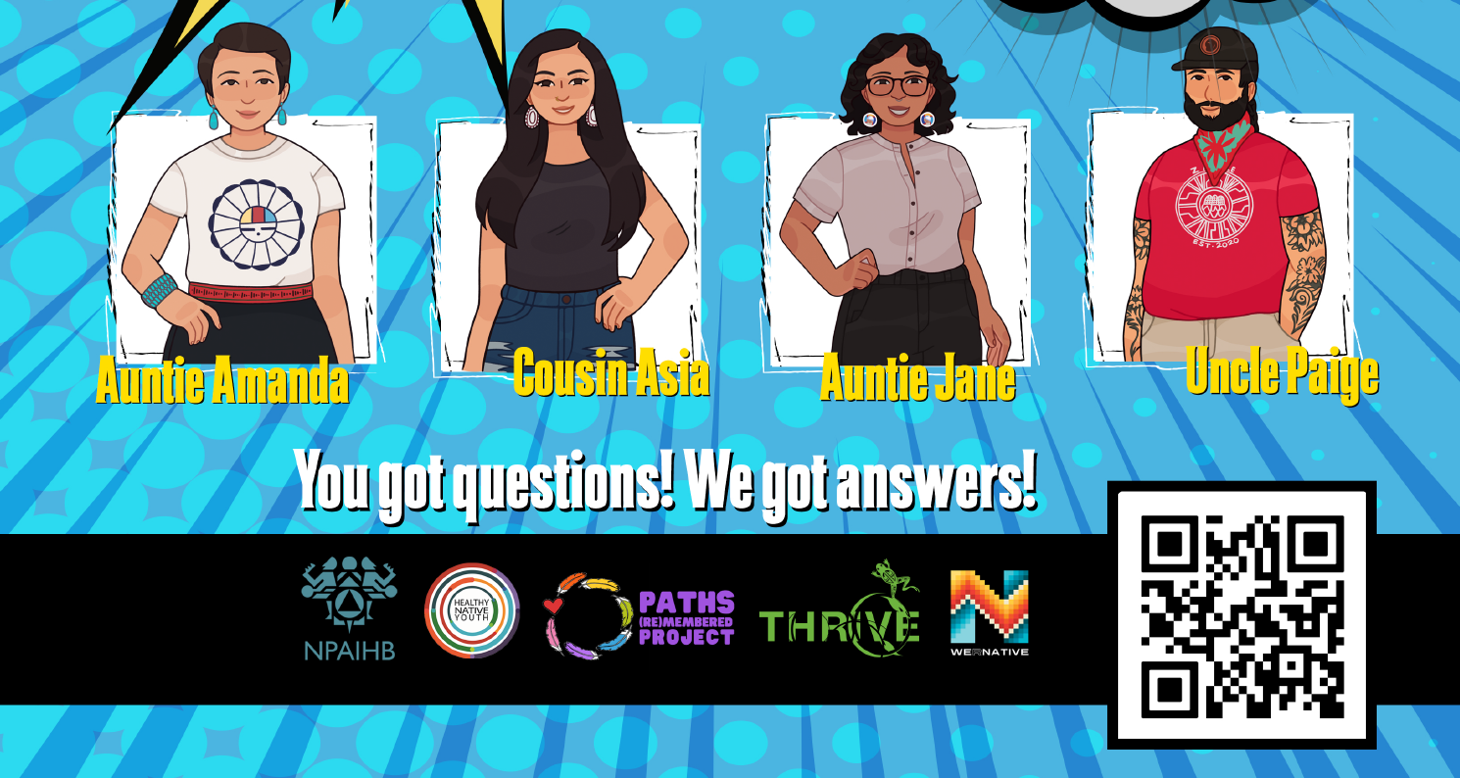
Notes:
The site also has an active Ask Your Relatives Q&A service, that answers sensitive questions.

Slide 5
Notes:
They partnered with the Northwest Native American Center of Excellence at OHSU.

Slide 6
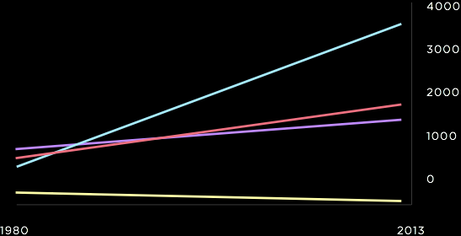
U.S. MEDICAL SCHOOL MATRICULANTS 1980-2013
AAMC Data Warehouse: Applicant and Matriculant File as of 10/14/2014

Slide 7
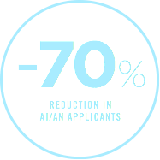
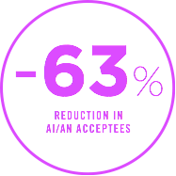
AI/AN APPLICANTS & ACCEPTEES 1996 - 2015
AAMC Data Warehouse: Applicant and Matriculant File as of 12/15/2016

Slide 8
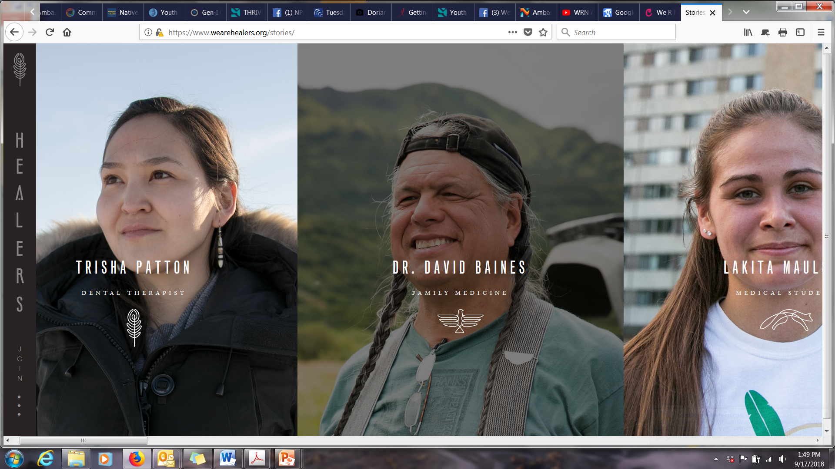
Notes:
And with We Are Healers, a non-profit that promotes health and wellness career pathways for AI/ANs.

Slide 9
Notes:
In collaboration…
We R Native, a multimedia health resource for Native youth, by Native youth.
OHSU - The Northwest Native American Center of Excellence (NNACoE) works to sustainably address the health care needs of all people by increasing the number of AI/ANs in the U.S. health professions workforce.
We Are Healers is a 501c3 non-profit initiative featuring stories of Native American health professionals. We aim to inspire Native youth to envision themselves as dentists, nurses, pharmacists, physicians, etc. – all through stories of Native role-models.

Slide 10
38 Youth have Enrolled To-Date
Notes:
Anyone can be a public health protector. Simply text INSPIRE to 94449 to sign up.

Slide 11
Notes:
When you sign up, we’ll send you text messages that share info about public health and videos from friends who work in public health – all with an Indigenous lens.

Slide 12
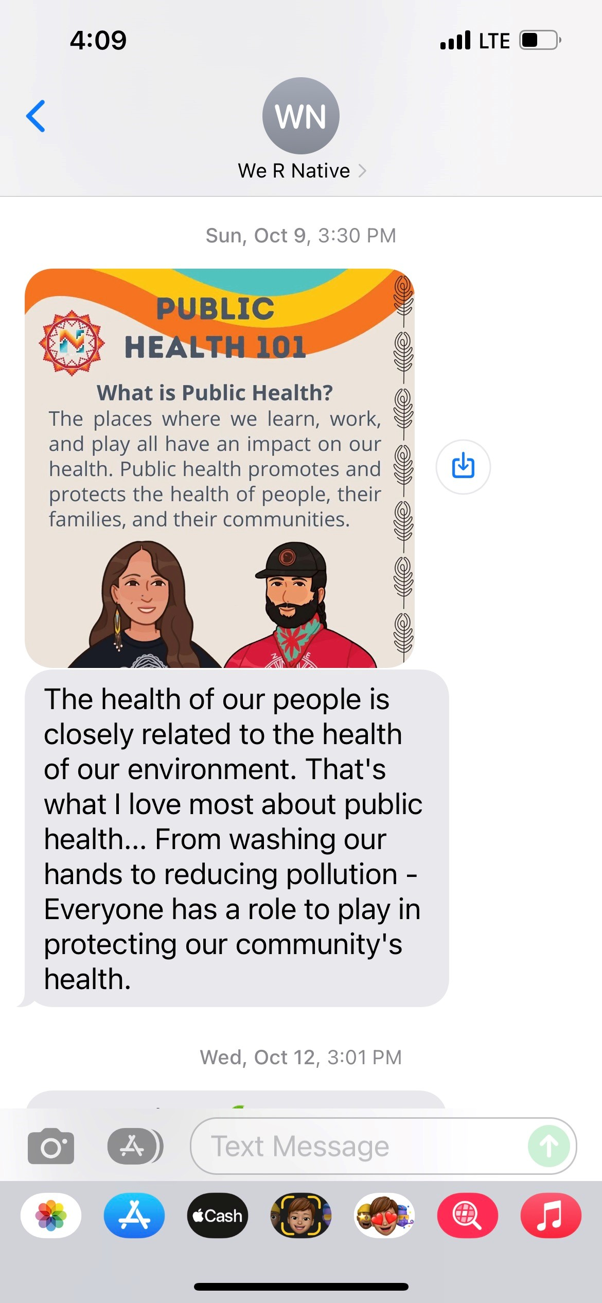
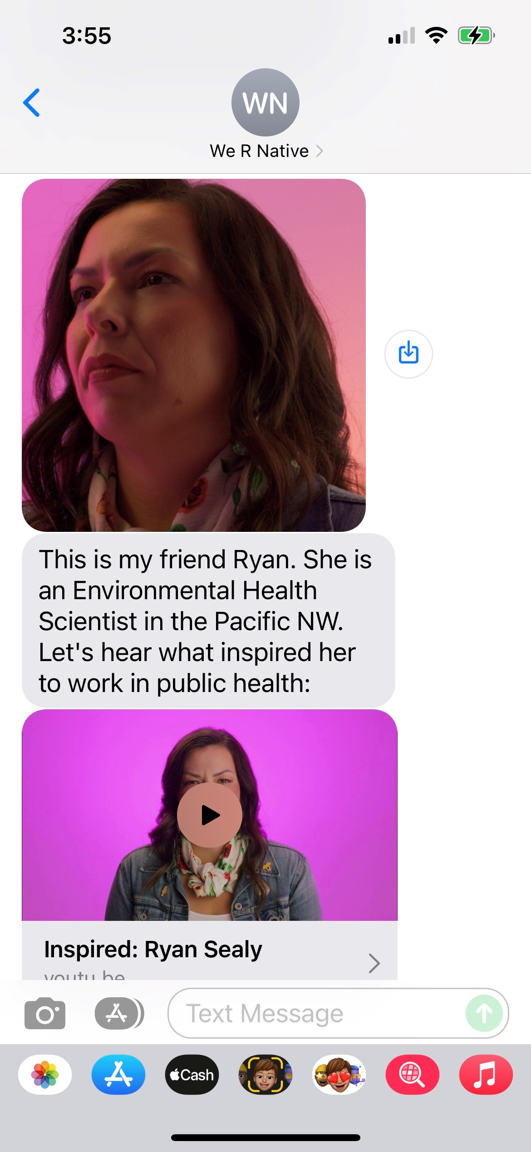
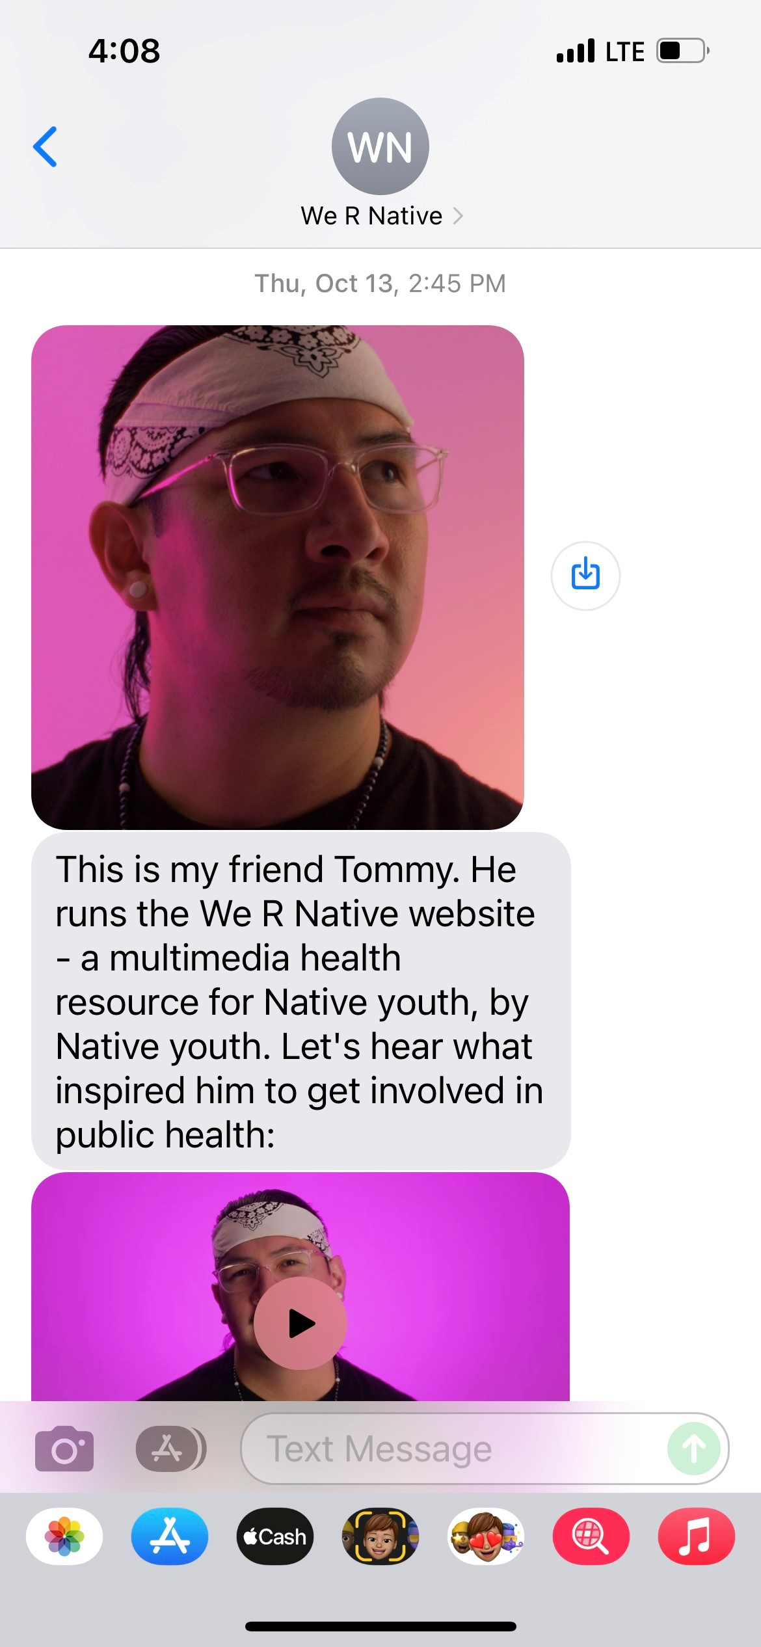
Notes:
Throughout the series, we’ll share tips and ideas to help you on your academic journey. Expect to get 2-3 text messages per week.

Slide 13
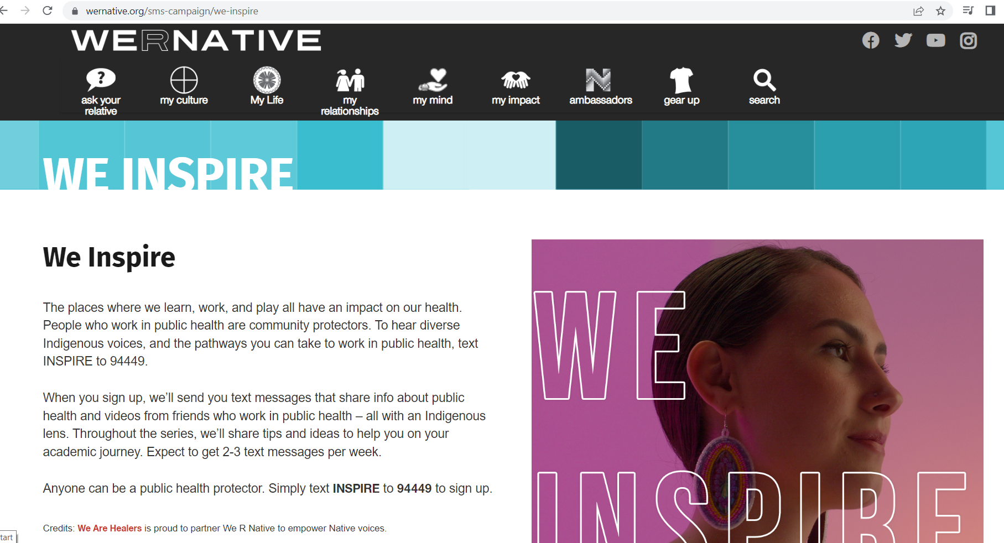
Notes:
We built a text messaging service to inspire the next generation of public health heros…
To hear diverse Indigenous voices, and the pathways you can take to work in public health, text INSPIRE to 94449.

Slide 15
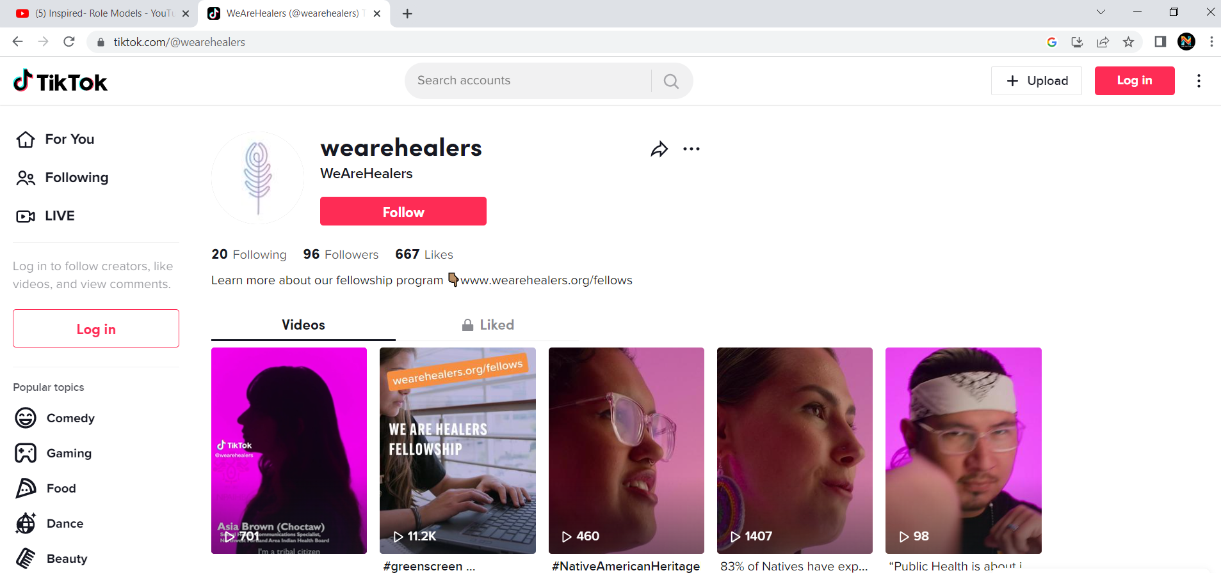
www.tiktok.com/@wearehealers
Notes:
You can also find us on TikTok

Slide 16
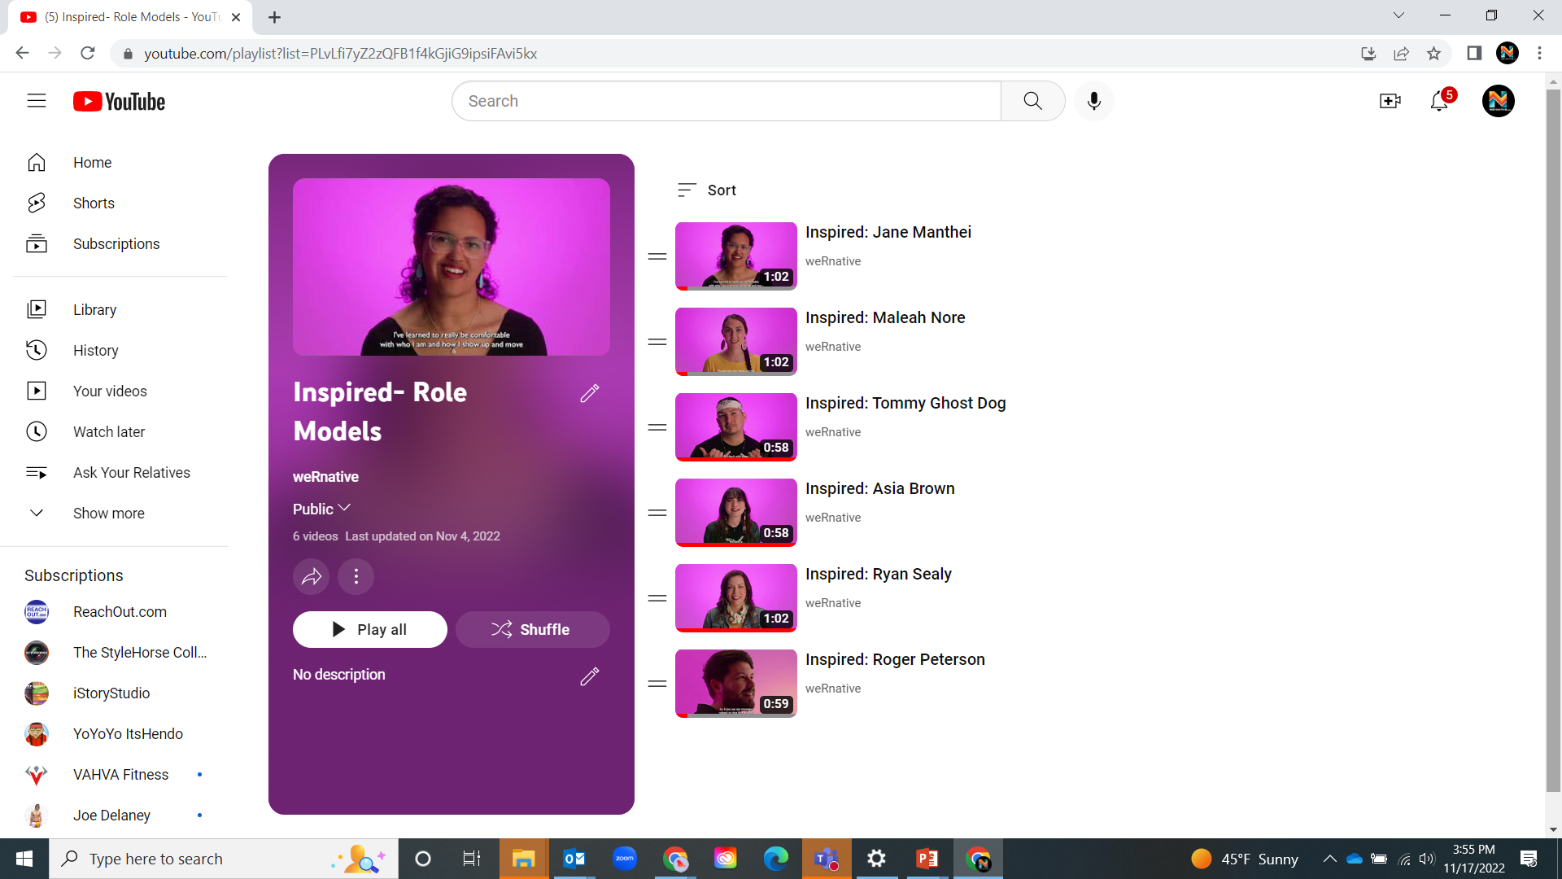
https://www.youtube.com/playlist
Notes:
The videos are available on YouTube

Slide 17
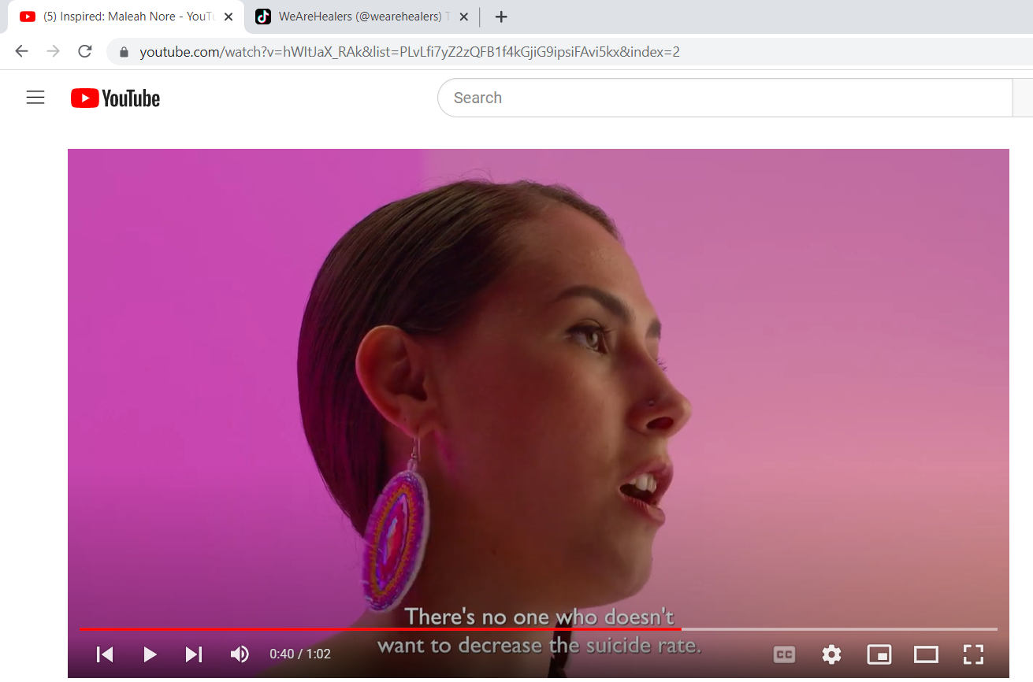
https://youtu.be/hWItJaX_RAk
Notes:
Maleah Nore (Tlingit) is the THRIVE Suicide Prevention Project Coordinator @NPAIHB

Slide 18
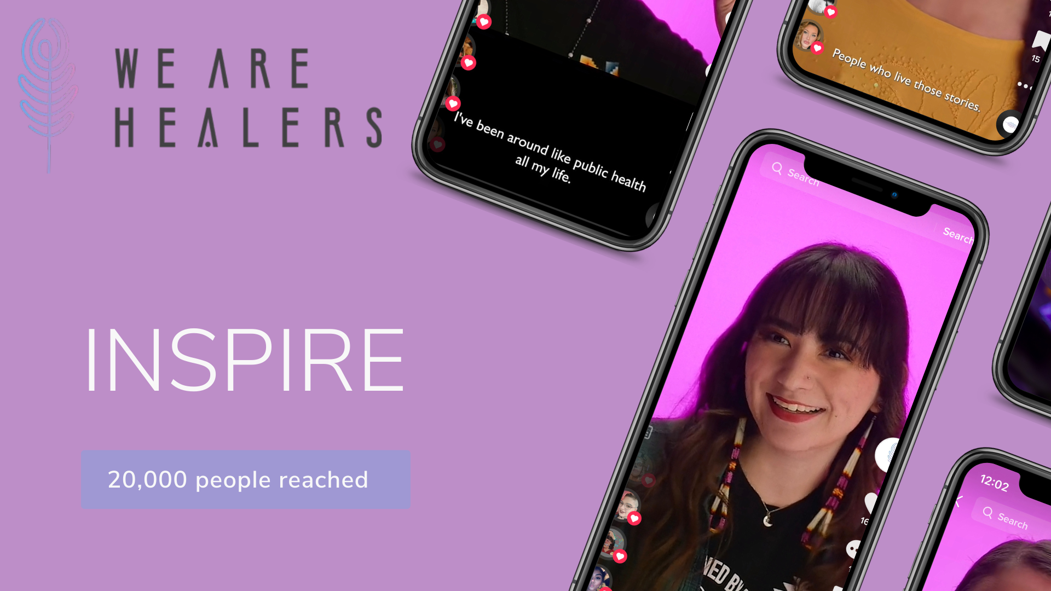
70,000 impressions / people reached

Slide 19
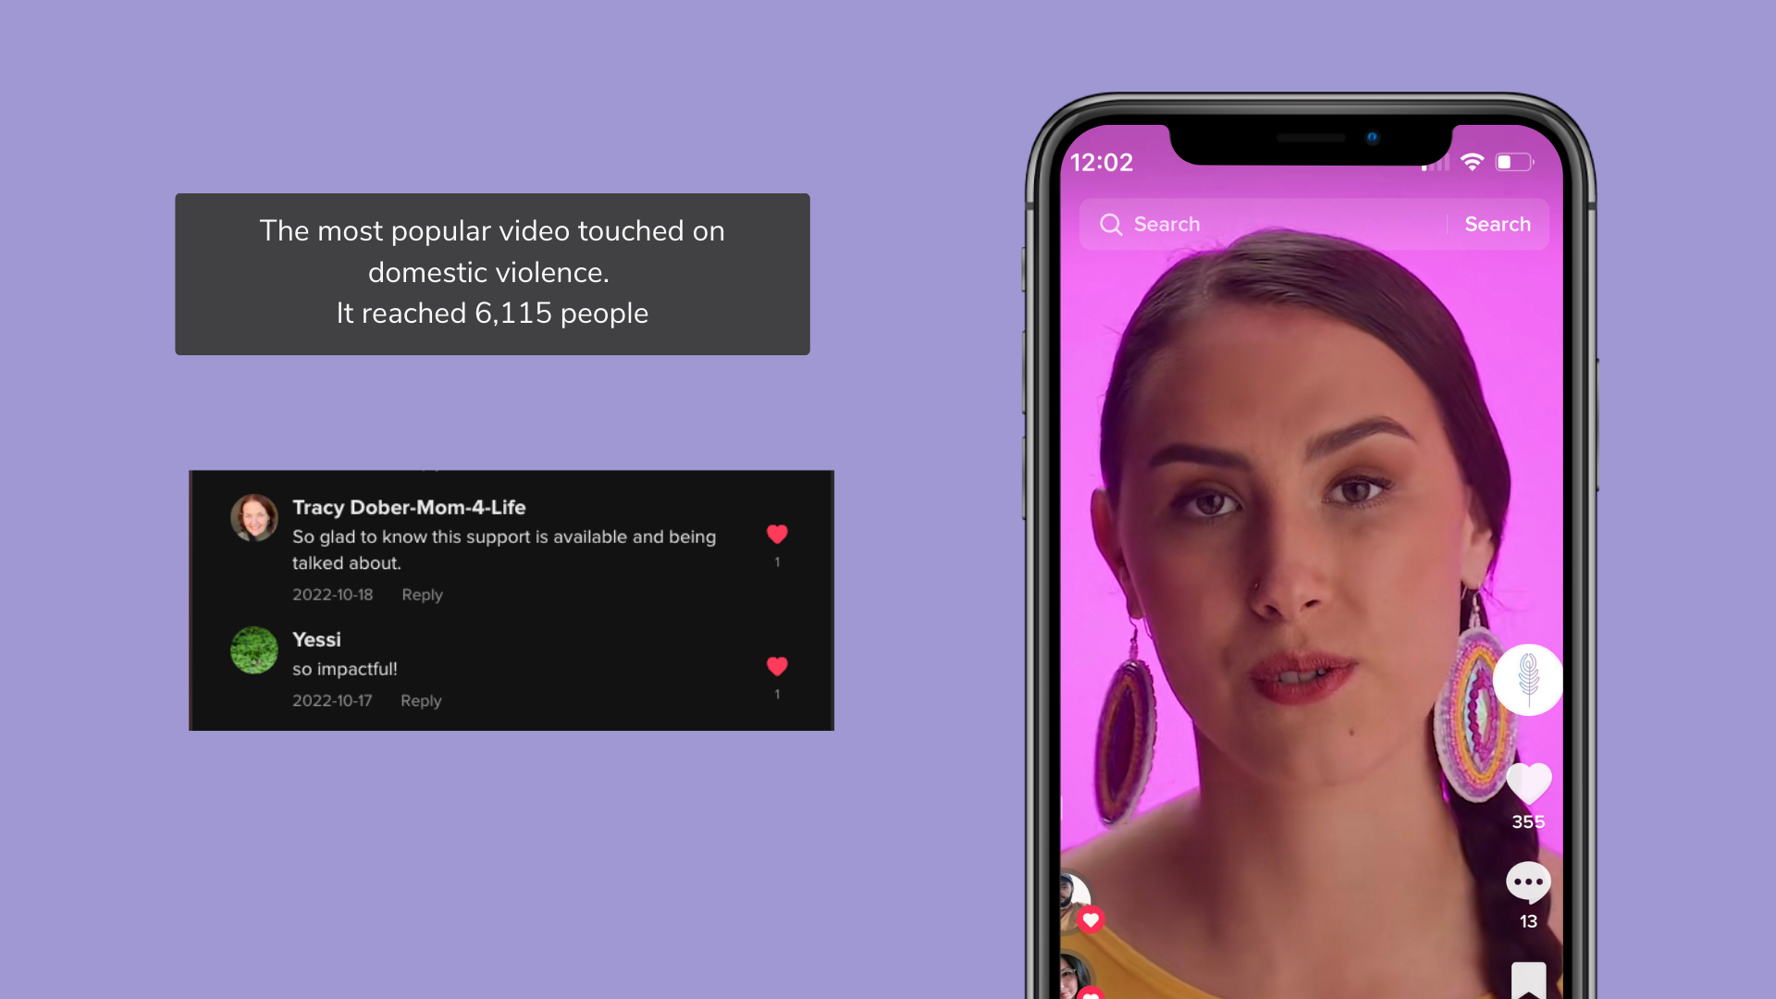

Slide 20
624 Youth have Enrolled To-Date
94449
94449

Slide 21
94449
500 Youth have Enrolled To-Date
Notes:
Designed a text-messaging campaign that encourages youth interested in Science, Technology, Engineering and Math (STEM), and connects them to role models in their field of interest.

Slide 22
Northwest Portland Area Indian Health Board
Stephanie Craig Rushing, PhD, MPH
Principal Investigator
scraig@npaihb.org
Jessica Leston, MPH
STD/HIV Clinical Services Director
jleston@npaihb.org
Colbie Caughlan, MPH
THRIVE Project Director
ccaughlan@npaihb.org
Celena Ghost Dog, MPH
WYSH Manager
cghostdog@npaihb.org
Jane Manthei
Text Messaging Specialist
rpeterson@npaihb.org
Amanda Gaston, MAT
Ask Auntie
agaston@npaihb.org
Maleah Nore
THRIVE Project Coordinator
mnore@npaihb.org
Tommy Ghost Dog
We R Native Coordinator
tghostdog@npaihb.org
Michelle Singer
Healthy Native Youth Manager
msinger@npaihb.org
Jerico Cummings
Youth Engagement Coordinator
jcummings@npaihb.org
Itai Jeffries, PhD
Manager, Paths (Re)Membered
ijefferies@npaihb.org
Corey Begay (Contractor)
Multimedia Specialist
cbegay@npaihb.org
Open
Healthy Native Youth Outreach
jmanthei@npaihb.org
Asia Brown
Sexual Health Communications
ambrown@npaihb.org
Grazia Cunningham, MPH
NARCH Manager
gcunningham@npaihb.org

