Slide 1
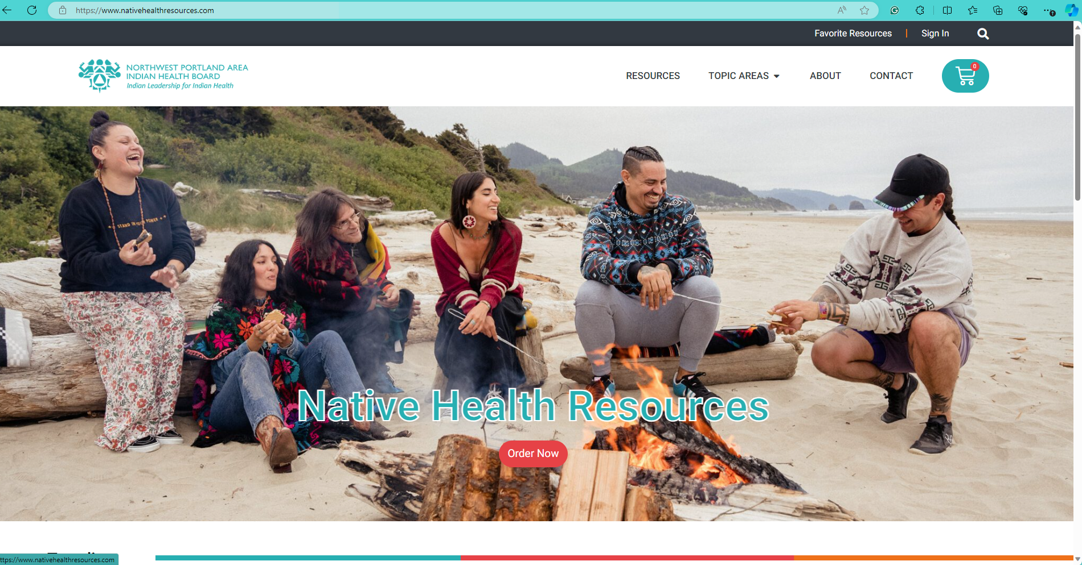

WWW.NATIVEHEALTHRESOURCES.COM
Notes:
1 slide - ONLY

Slide 2
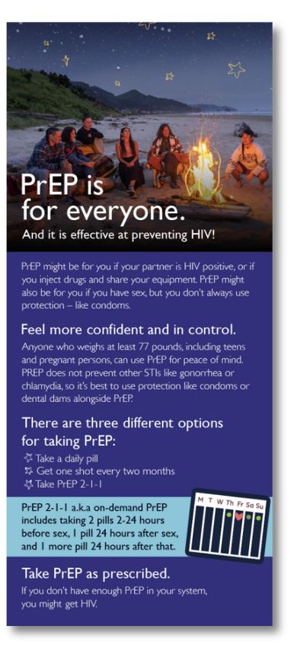
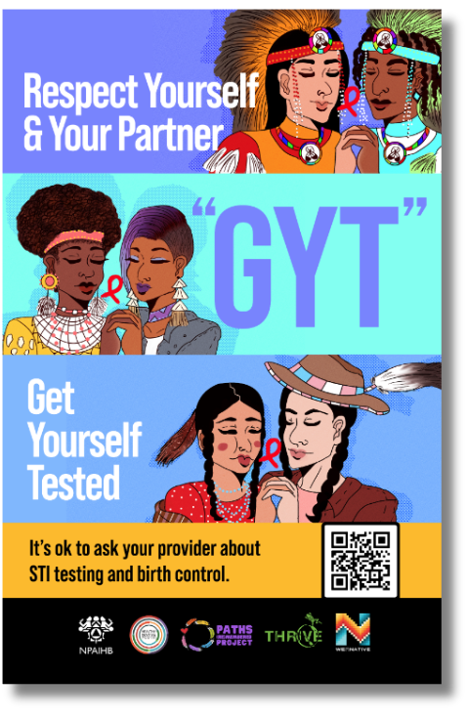
WHAT IS NATIVE HEALTH RESOURCES?
To address the barrier of finding culturally relevant, modern, and accurate health education materials, the Northwest Portland Area Indian Health Board created the Native Health Resources website. This site was developed as a one-stop shop for Indigenized health education materials. The materials on the website can bolster health education efforts for various clinicians, health educators, and others serving Tribes and Tribal organizations.
Notes:
Slides 2 - 4 - ONLY

Slide 3
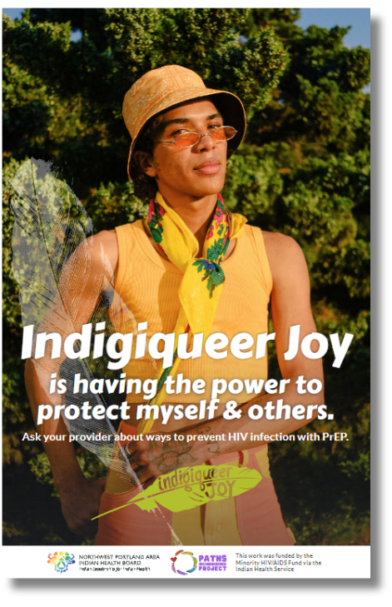
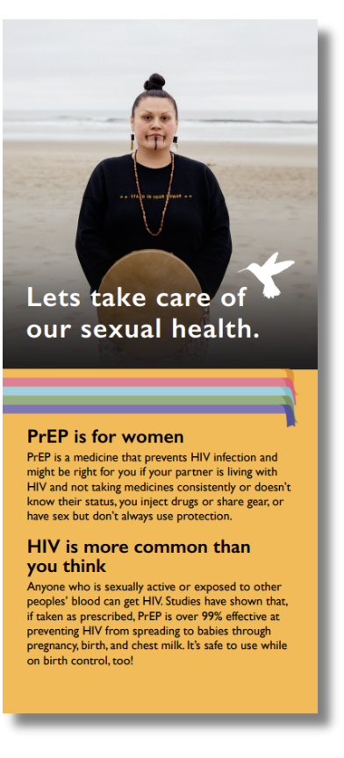


CHECK OUT THE SITE!
Scan Me!
Notes:
1 slide - ONLY

Slide 4
FOR MORE INFORMATION!
Please contact Alicia Edwards, HIV Program Manager, at aedwards@npaihb.org

